Slide 1

Project Tracker
by Code Crafters
Tarak
Prasanna
Aneesh
Pavan
Akshay

Slide 2
Project Tracker
Roles
Everyone acts as a designer, developer, and tester for each component.
Everyone acts as a scrum master for each sprint meeting.
Everyone also acts as product owner/stakeholder to the other components to provide feedback, validation and enhancement ideas

Slide 3
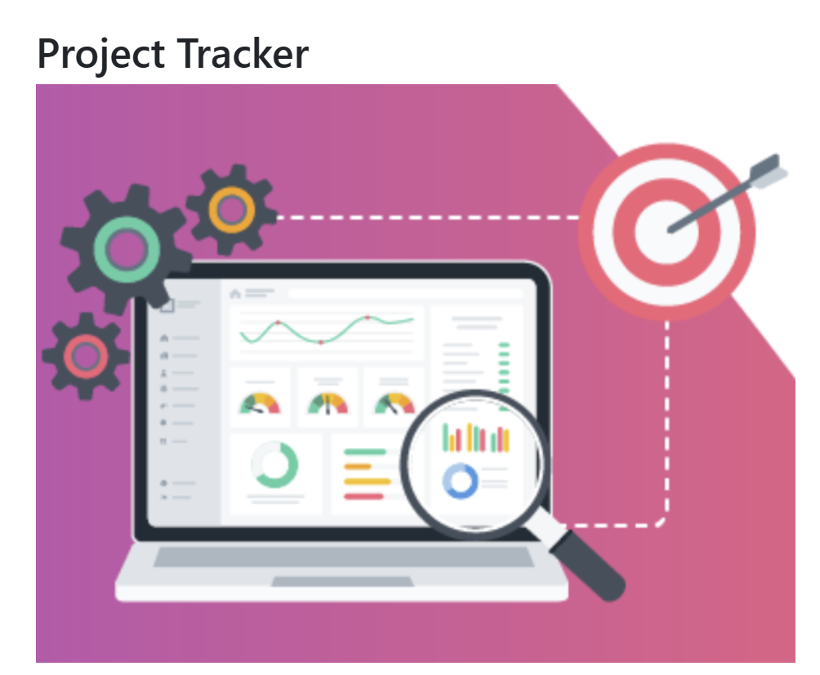
Project Tracker
Overview
What is it?
- Project Tracker is a user-friendly web application for managing projects, contracts, and employees in organizations.
What does it do?
- It helps admins and admin privilege users to add, edit, and delete projects, contracts, and employees, and approve user roles.
Why use it?
- It replaces traditional methods like Excel, offering easier access, stats, and secure authentication.

Slide 4






Outline
Project Tracker

Slide 5
Project Tracker
Technical Requirements
Frontend:
Programming Languages: JavaScript
Front-end Framework: React
Version Control: GitHub
Authentication: Implement secure user authentication like JWT(JSON web token) Authentication
Backend:
Back-end Framework: Node.js(Express.js), Mocha(unit test framework)
Authentication: Implement secure user authentication like JWT(JSON web token) Authentication
Database:
Database: MongoDB
ODM: Mongoose
Tools:
Postman
Visual Studio
Studio 3T

Slide 6
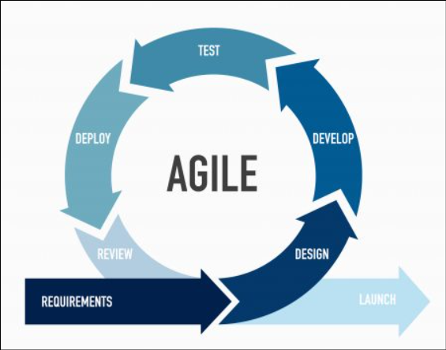
Project Tracker
Methodology
Agile Methodology:
Weekly sprints
Weekly meetings – Teams or in-person.
Functionality discussions and enhancements ideas.
Everyone acted as scrum master, developer.
Everyone acted as stakeholder and product owner to validate and enhance the other teammate component development.
Backlog refinement

Slide 7
Project Tracker
Architecture
Client (React)
Server
(Node.js)
Data Base
(Mongo DB)
Port: 3001
Port: 4001
Port: 27017

Slide 8
Project Tracker
Components
User Registration
Admin User Creation
User Login
Users
Dashboard
Projects
Contracts
Employees
Settings

Slide 9
Project Tracker
User Registration
Introduction
To access the application, an employee should register with their details.
Registered user is in active mode.
Only admin users/admin privilege users can activate the registered users.
Requirements
A register form will provide with following fields.
Username: Unique, no suggestions, error for duplicates.
Email: Valid format, case-insensitive, unique, error for duplicates.
Password: Min 8 characters, enforce complexity (uppercase, lowercase, digit, special symbol), masked input, error for invalid passwords, no suggestions.
Confirm Password: Must match password, error for mismatch.
Login Link: Navigate to the login page and Clear the login form upon click.
Register Button: Validate payload and show proper registration status.
User story
As an employee, I want to sign up for a new user account on the platform so that I can access its features and functionalities. I will need to provide a distinct username, email address, and password

Slide 10
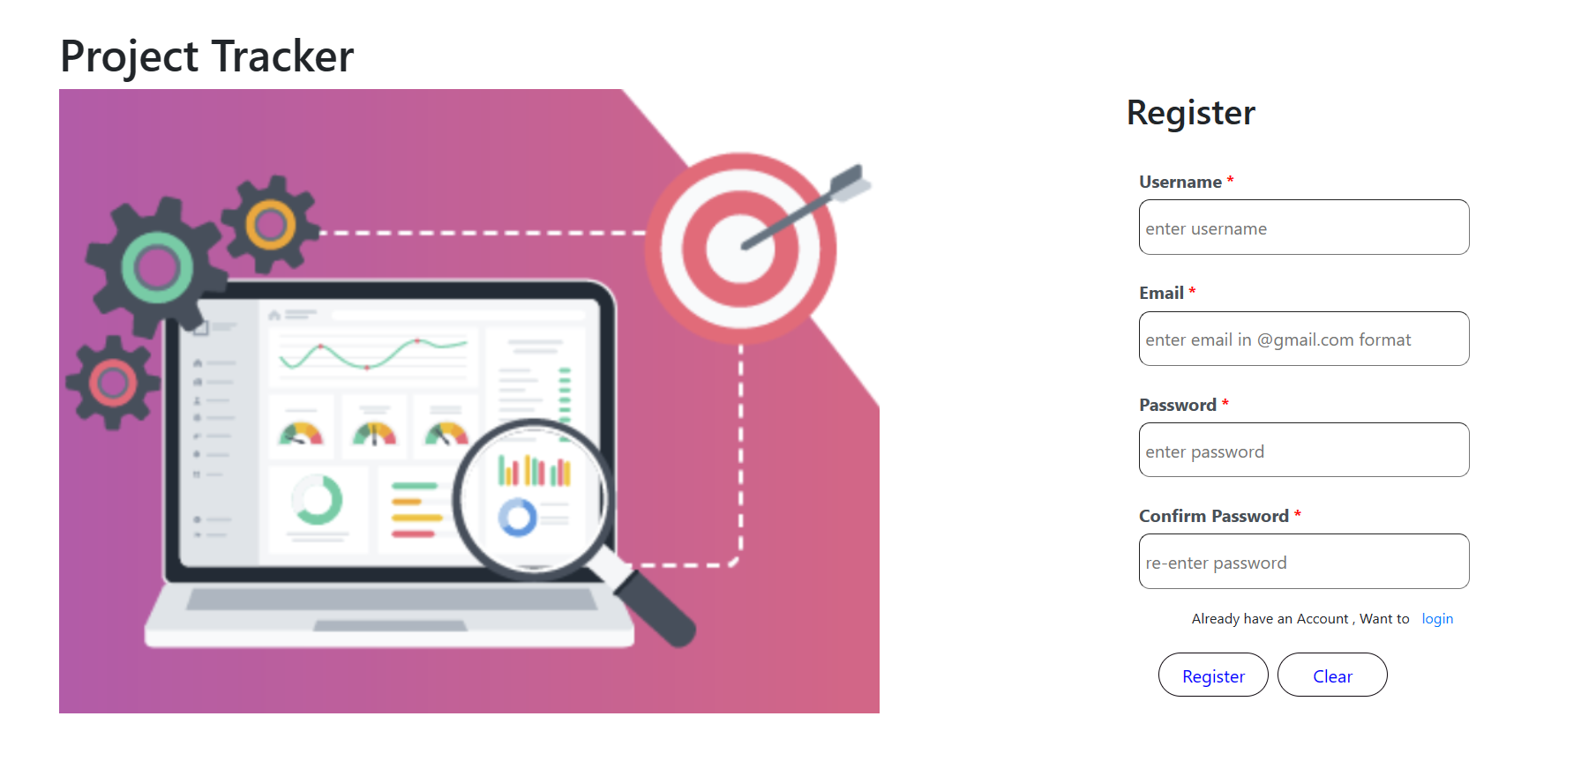
Register Form UI

Slide 11
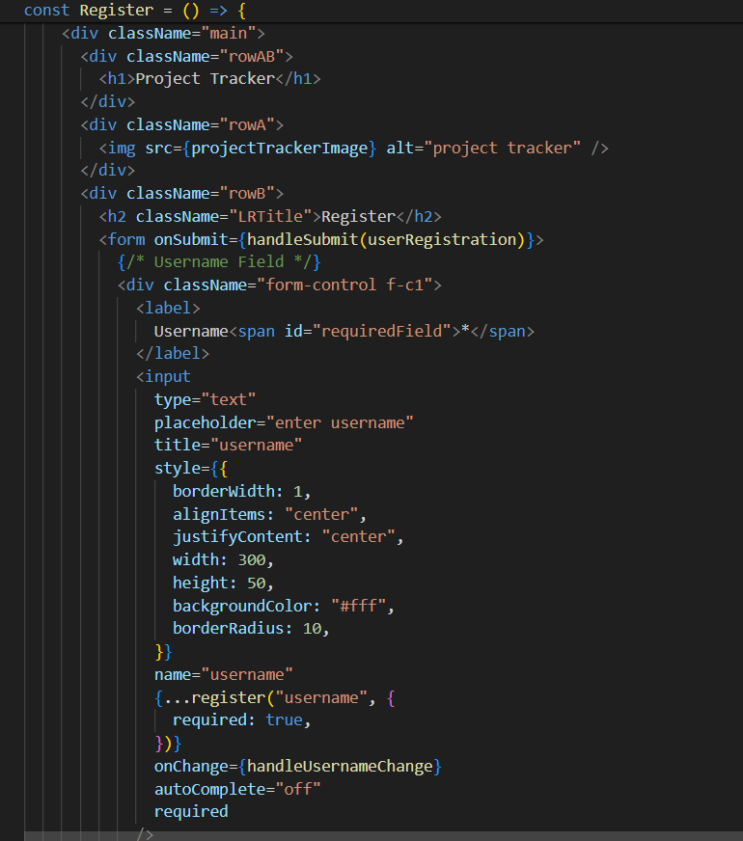
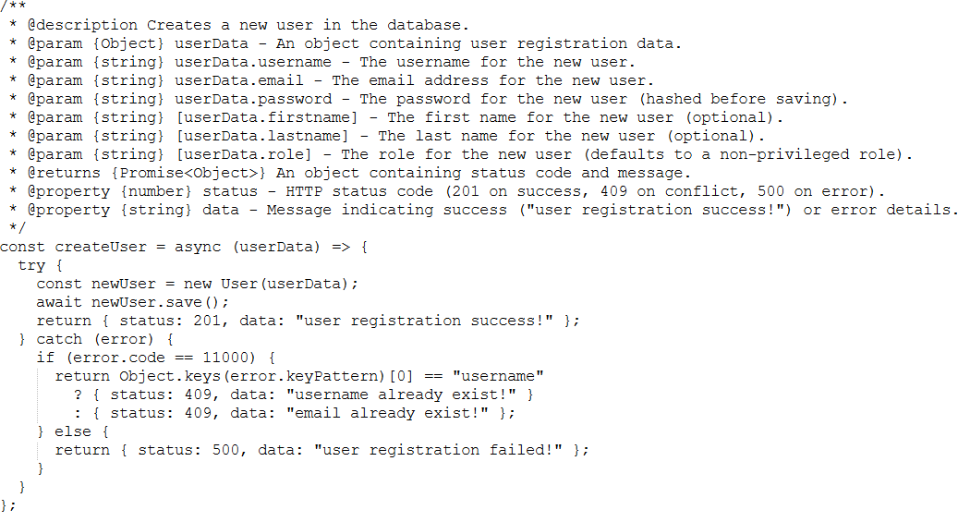
Project Tracker
Code Snippet

Slide 12
Project Tracker
API’s
Get registered users
Endpoint: /v/getUsers
Method: GET
User Register
Endpoint: /v/register
Method: POST
Request payload :
{"username": "Test", "email": "test@gmail.com", “password”: “Test@1234”, "confirm_password": "Test@1234"}

Slide 13
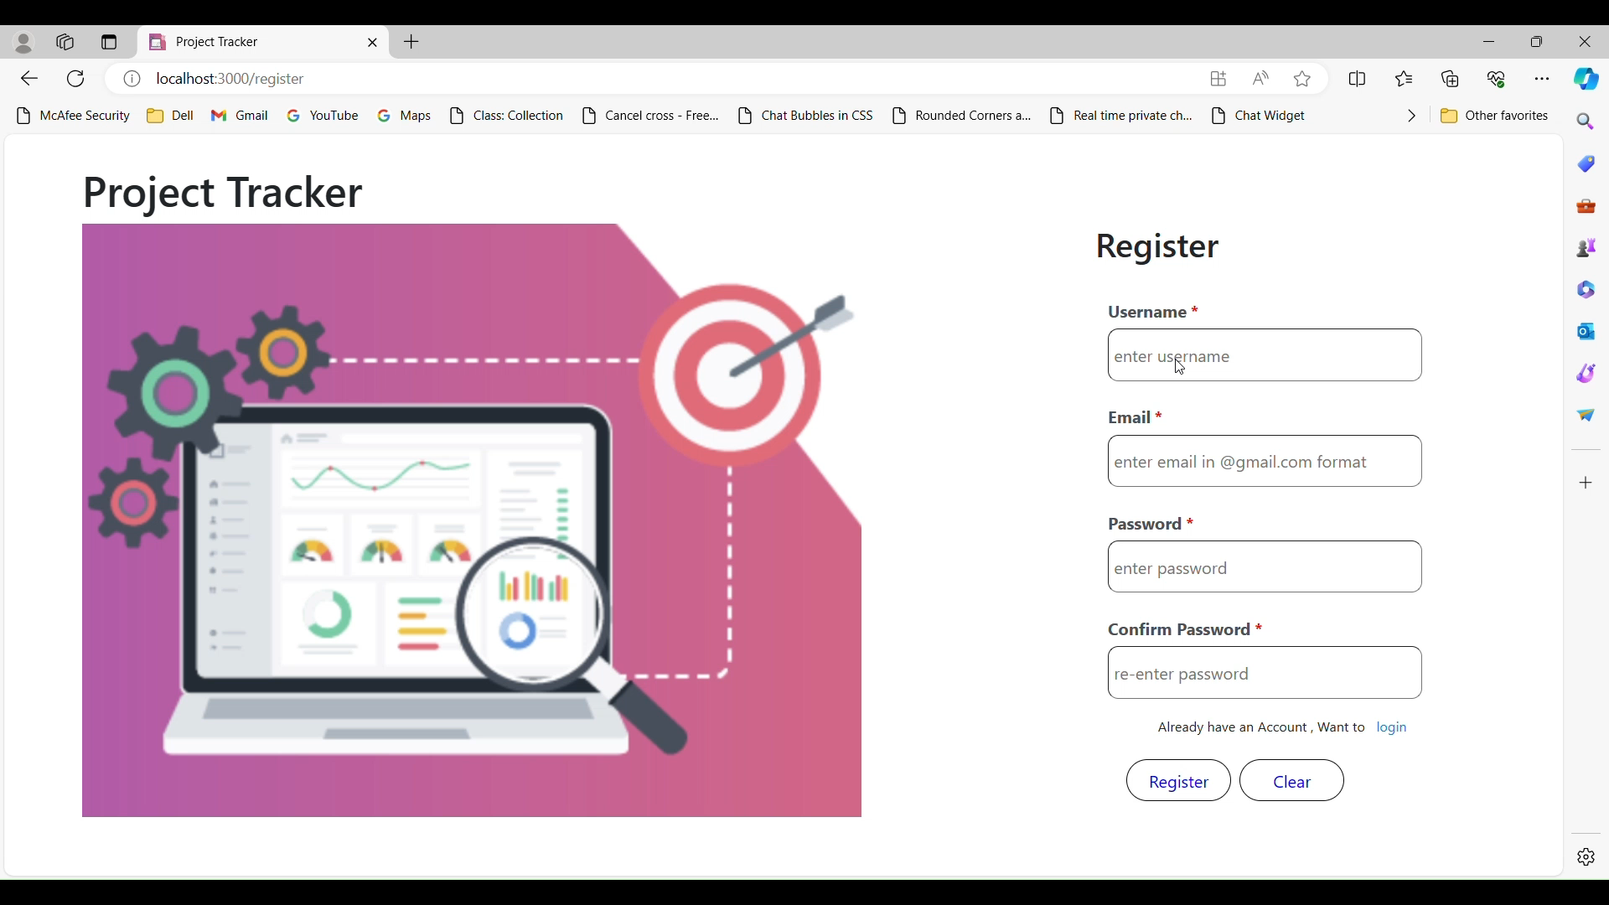
Project Tracker
Evaluation Criteria
Secure user registration form with validation unique username, email, and strong password with confirmation, clear error messages, and successful registration/failure toast notification.

Slide 14
Project Tracker
Admin User Creation
Introduction
In the project tracker web application, the admin user holds the highest level of authority and responsibility.
Privileges
Access to all features and functionalities of the project tracker web application.
Authority to create and modify user accounts.
Oversight of project/employee data, including creation, editing, and deleting.
Requirements
REST API to create an admin user for the application
User Story
As a system administrator, I want to create a new admin user through a secure API endpoint, providing their username, email, password, and optional name information, so that I can manage system access and assign administrative privileges

Slide 15
Project Tracker
Admin User API format
API Type : REST
Method : POST
End point : /v/adminUser
Authorization : Basic Auth
Request Body :
{
"username": "adminUser",
"email": "test@gmail.com",
"password":"Pwd@1234",
"firstname": "fname",
"lastname": "lname",
"role":"admin"
}
Response :
{
"status": 201,
"data": "Admin user created successfully"
}

Slide 16
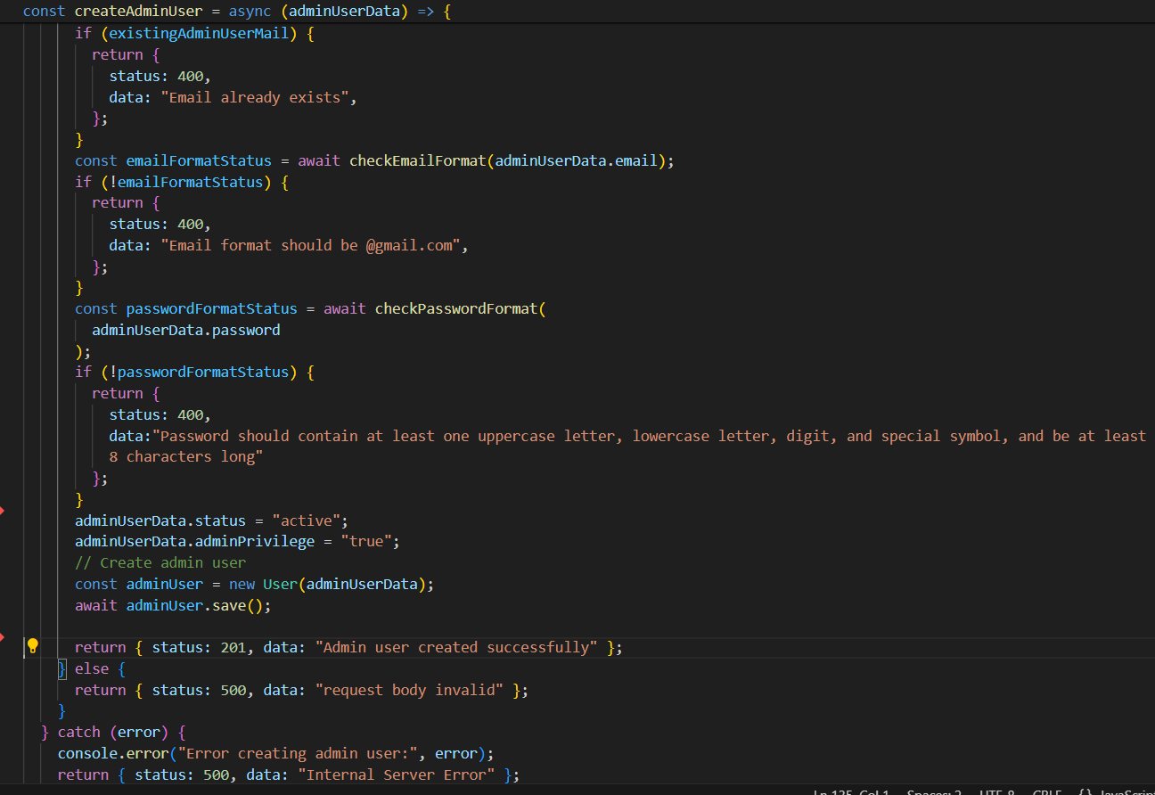
Project Tracker
Code Snippet

Slide 17
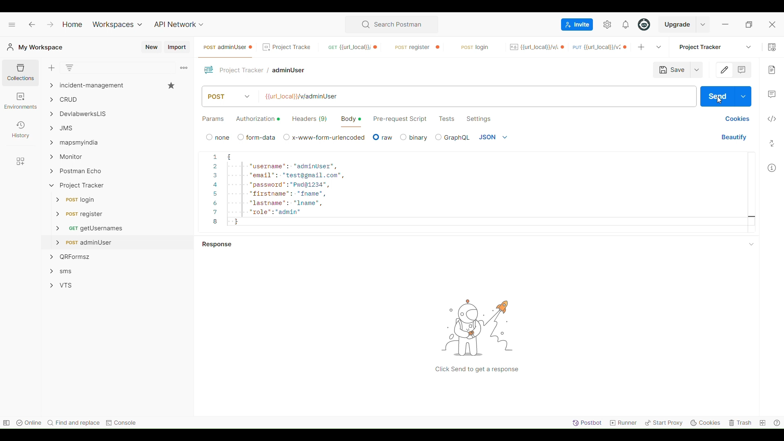
Project Tracker
Evaluation Criteria
Functionally creates admin via POST request with validated unique username, email, and strong password.

Slide 18
Project Tracker
User Login
Introduction
Active registered users can log in to the application to access the features based on the privileges.
When the user tries to log in, the data gets verified with the backend database and gets authenticated
Requirements
A login form with the following fields
Username: Text Field (mandatory), no suggestions.
Password: Text Field (mandatory), Minimum 8 characters, Enforce complexity (uppercase, lowercase, digit, special symbol).
Register Link: Navigate to the register form and clear the login form upon clicking.
Login Button: Submits form data
User Story
As a registered user, I want to log in to the application using my username and password so that I can access its features and functionalities

Slide 19
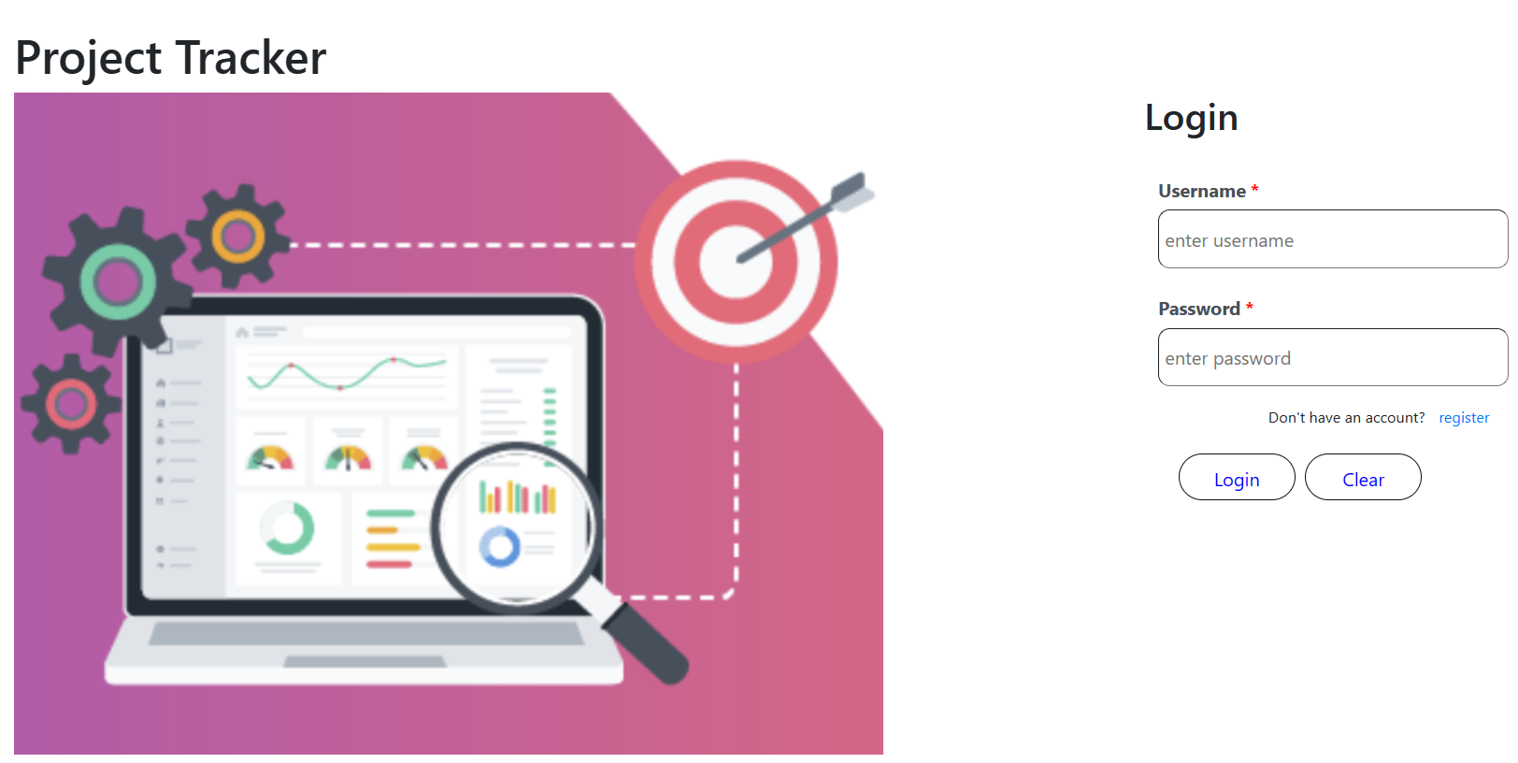
Project Tracker
User Login Form UI

Slide 20
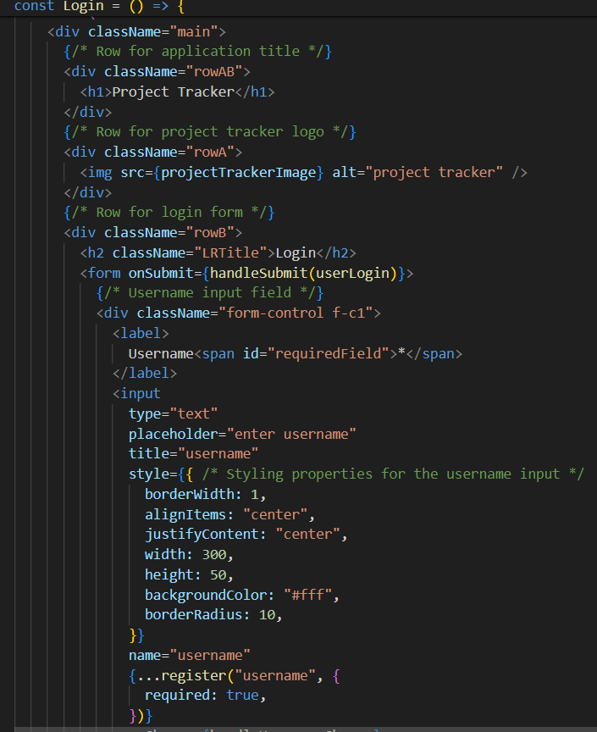
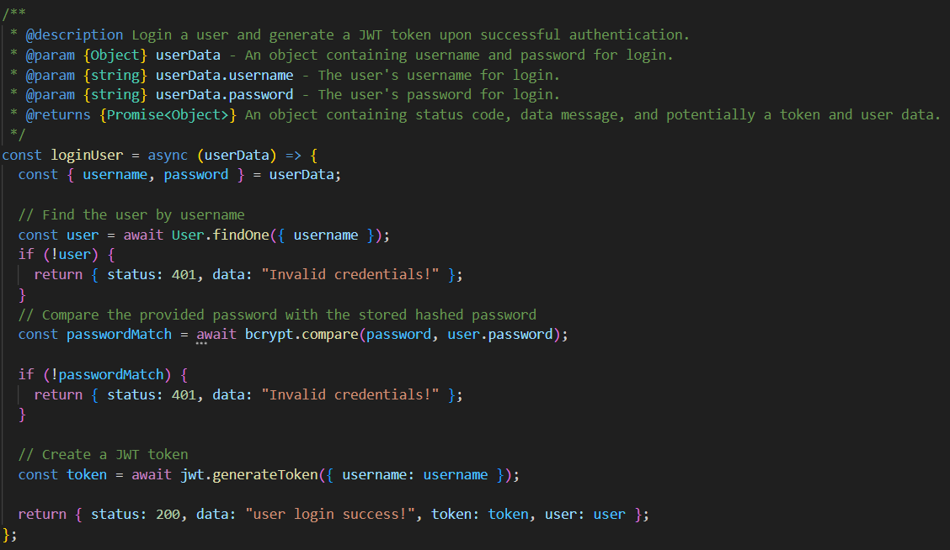
Project Tracker
Code Snippet

Slide 21
Project Tracker
API’s
Get registered users
End point : /v/getUsers
Method : GET
User Login
End point : /v1/login
Method : POST
Request payload :
{"username":"adminUser","password":"Pwd@1234"}

Slide 22
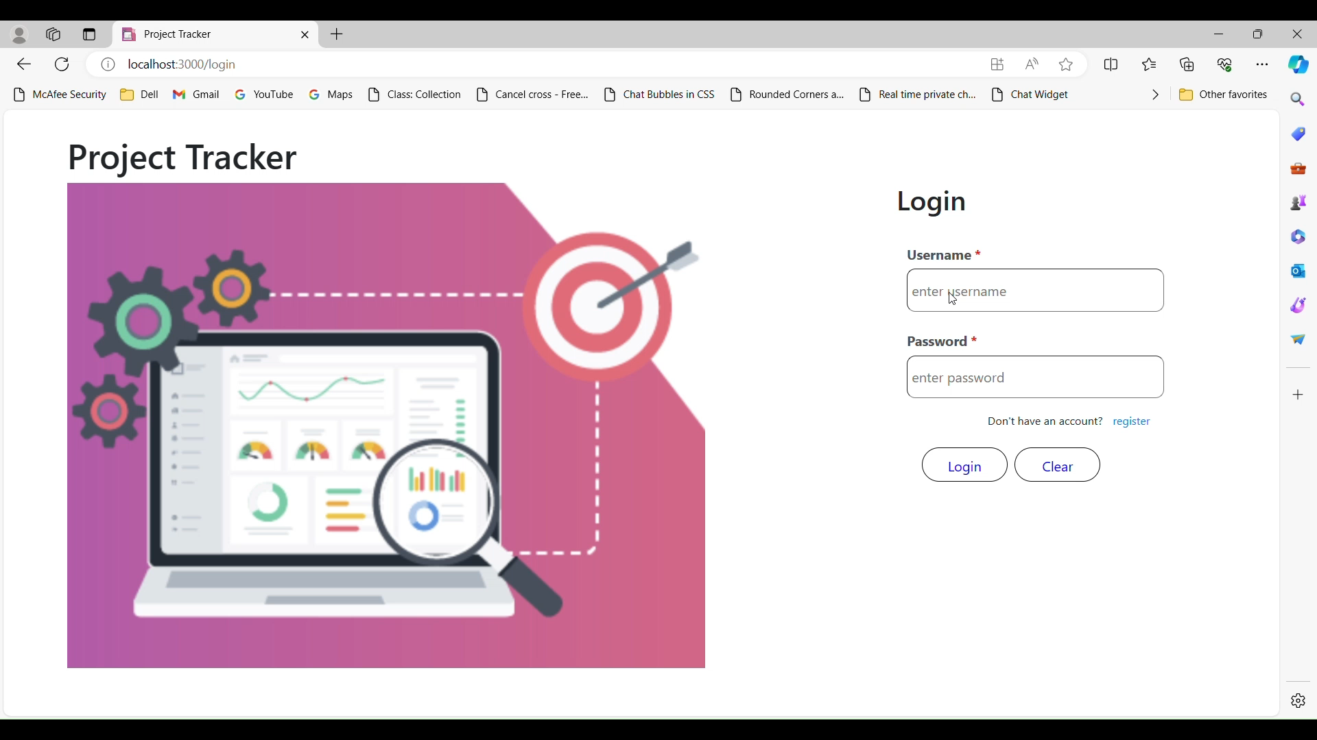
Project Tracker
Evaluation Criteria
Secure user login form with validate username and strong password, masked input, and clear error messages. Form clears after submission.

Slide 23
Users
Project Tracker
Introduction
The user page will allow to display user’s privileges and also allow admin privilege users to update privileges except admin role users. All the changes act like a query to the database and the tables get modified accordingly
Requirements
A table displays all registered users with:
Username, Email, Status, Role, Admin Privilege
Edit Option: Only admins can edit users. Clicking "Edit" opens the edit form for the selected user.
Edit User Form:
Pre-populated with existing user data: Username (read-only), Email, Status (editable dropdown)
Role (editable dropdown), Admin Privilege (editable checkbox)
Allows admins to modify: User Status, User Role, Admin Privilege
User Story
As an admin privilege user, I would like to examine user information, including username, email, status, role, and admin privilege, and also update status and privilege.

Slide 24
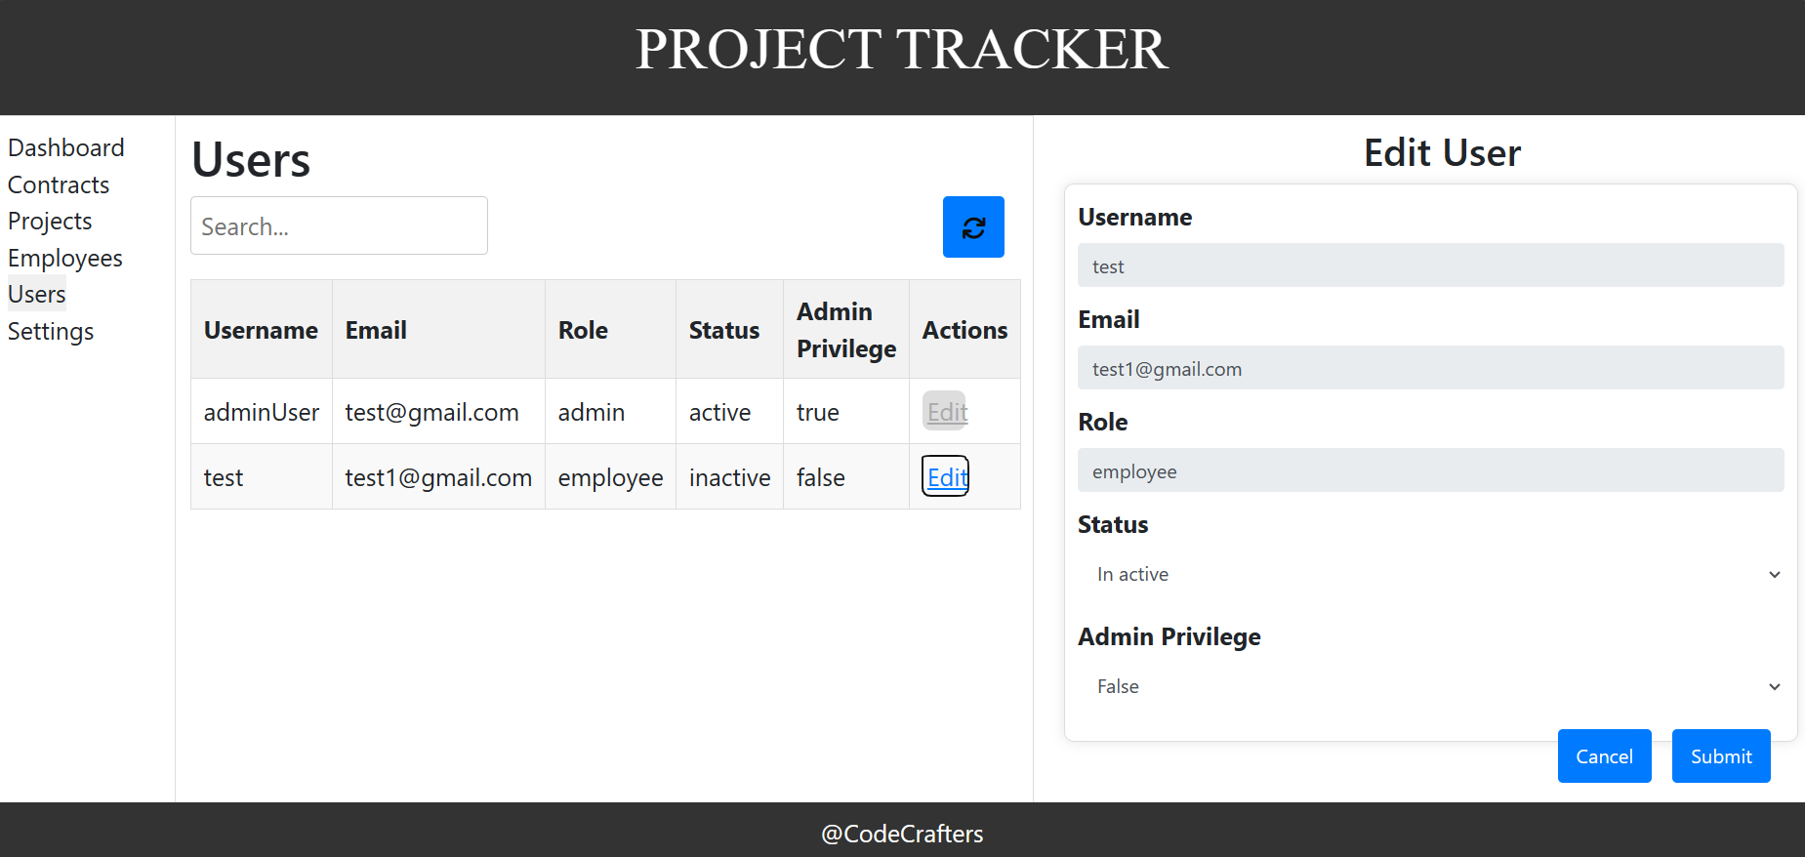
Users Tab UI

Slide 25
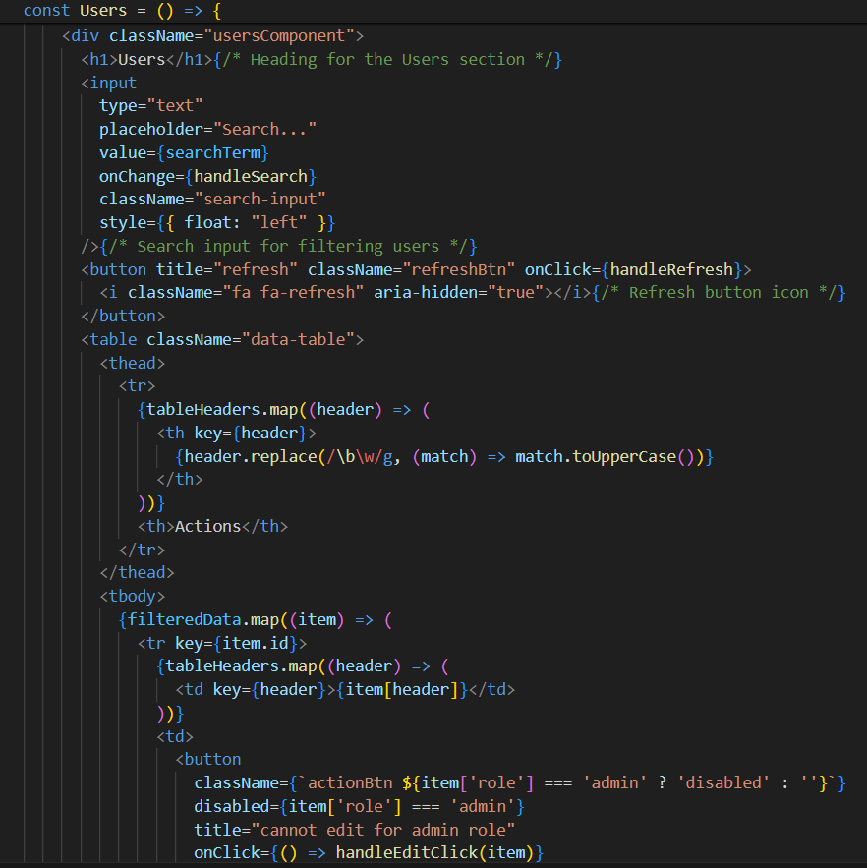
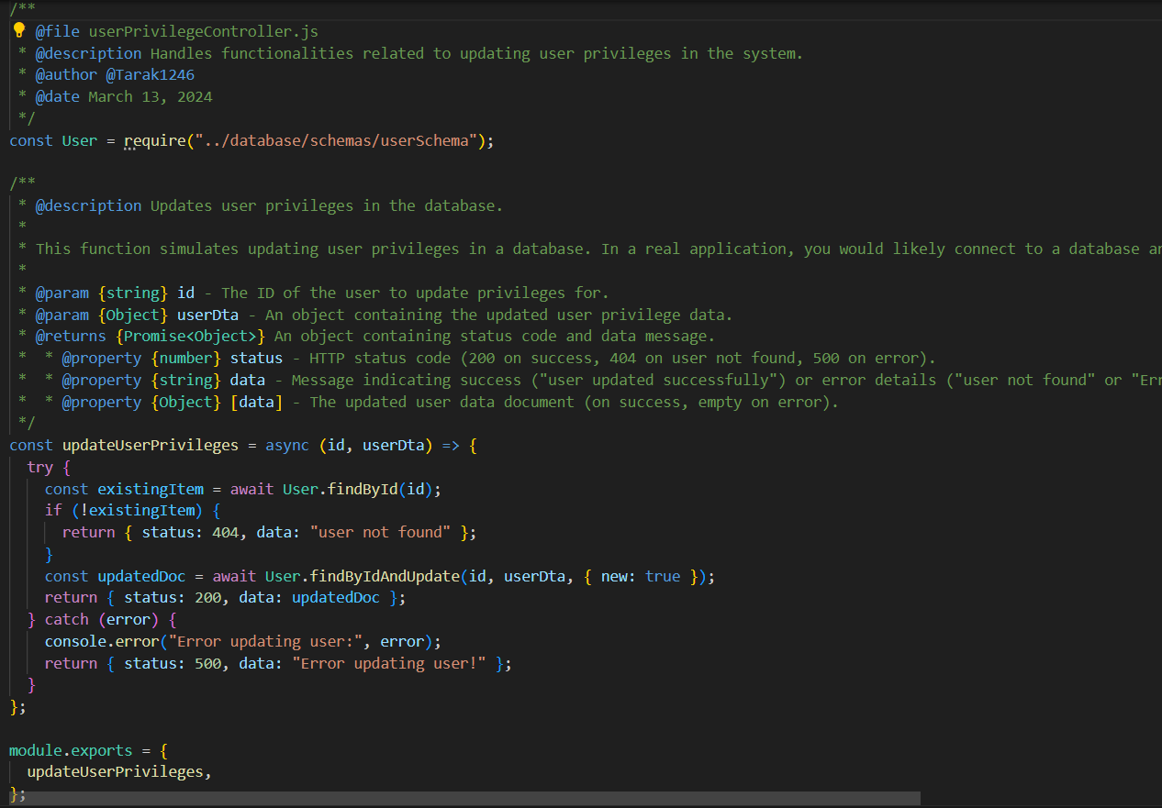
Project Tracker
Code Snippet

Slide 26
Project Tracker
API’s
Get registered users
Endpoint: /v/getUsers
Method: GET
Authorization: JSON Web Token
2. Update user information
End point : /v2/updateUserPrivileges
Method : PUT
Authorization : JSON Web Token
Request payload :
{"username":"tarak123","email":"taraksai@gmail.com","role":"employee","status":"active","admin privilege":"true","adminPrivilege":"true"}

Slide 27
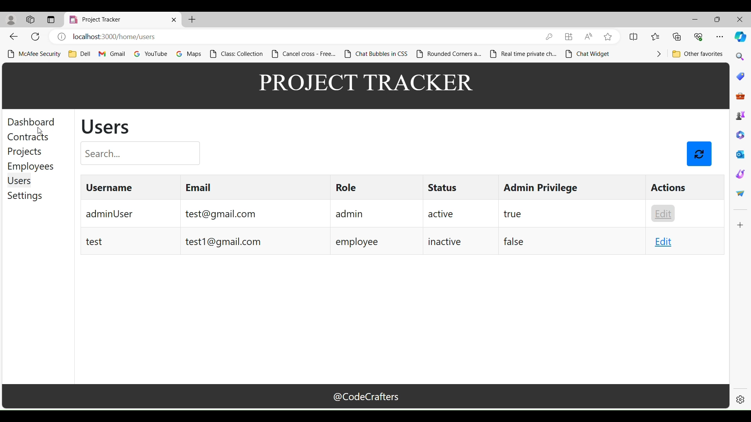
Evaluation Criteria
Project Tracker
Admin-only user management page listing all users in a table with username, email, status, role, and admin privilege. The edit option allows admins to edit user data (status, role, and potential privilege) within a dedicated form

Slide 28
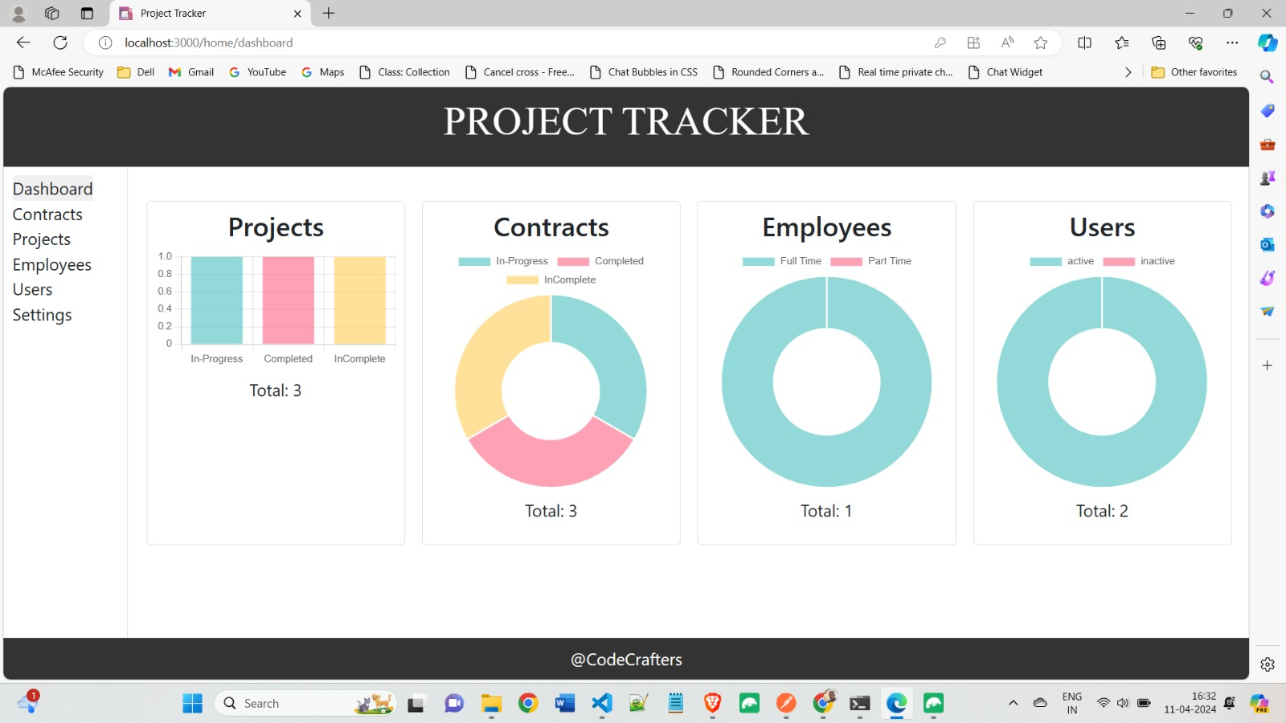
Project Tracker
Dashboard Functionality

Slide 29
Project Tracker
Introduction
The Dashboard module aims to provide users with a graphical representation
Privileges:
Access to Graphical Representation
Access to Metrics
Dynamic Updates
Responsive Design
Compatibility
User Story:
Dashboard developers provide dynamic visual modules for the system, showing project progress and employee information via graphs/charts that automatically reload as the underlying data changes.

Slide 30
Project Tracker
Requirements
Projects
Contracts
Employees
Users
Any changes made to the Projects tab can seen in the Projects chart here
The Contracts data can be easily tracked here by checking the pie chart
All the status of the employees is tracked here for the fast representation
The Users data is shown here

Slide 31
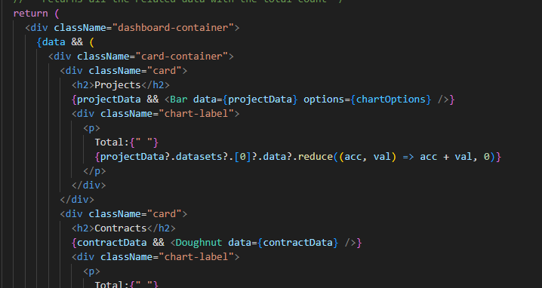
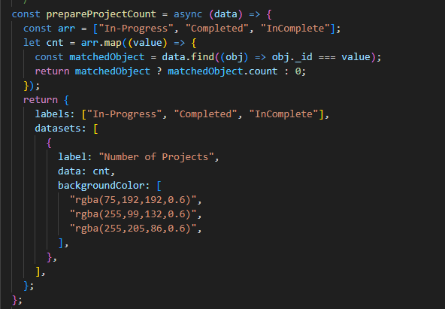
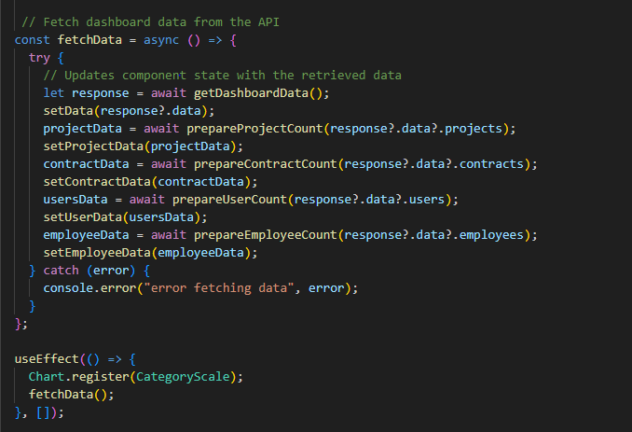
Project Tracker
Code

Slide 32
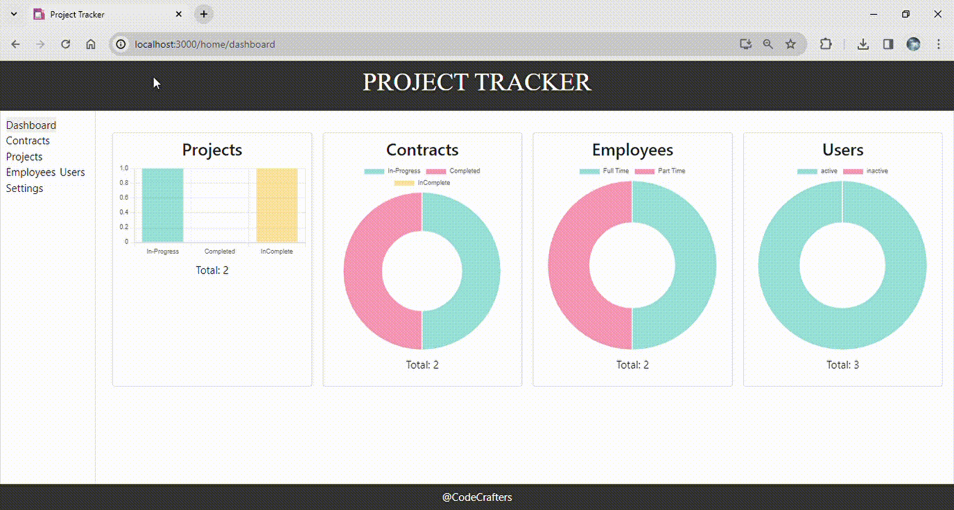
Project Tracker
Evaluation criteria

Slide 33
Project Tracker
Projects Component
Introduction: Projects tab serves as a central hub for managing project details within our organizational project management platform. It consolidates all project related information, offering a single point of access to stay updated on projects status and details. Comprehensive functionality and performing tasks seamlessly: Provide the ability to add, edit, delete and view the projects across the organization. Real-time data updates. User friendly interface and display data in tabular format. User Story: As a user, employee, or admin in the organization, I want to efficiently access, manage(add, edit, delete) and track project details. As a user, I require critical project information to be presented in a user-friendly tabular format, including project name, dates, members, progress, and status. As a user, it is crucial that certain project details are unique, preventing duplicate entries and ensuring data integrity. As a user, I expect a responsive and friendly user interface, with complete with features like search, confirmation dialogs, and feedback messages to facilitate seamless project management.

Slide 34
Project Tracker
Projects Component – Requirements
Projects Listing:
Display all project records in the tabular view.
Include key data items ID, Name, members, client, Start/End date, deadline, progress & status, actions.
Action Buttons:
Each project record provides an action buttons for user to edit and delete them.
Search box to find specific information.
Add button action to create a new project record and update in database.
The projects component presents projects details dynamically, reflecting the changes in the database in the real time.
The ID and name of the project should be unique.
Members field should represent the number of people involved in the project.

Slide 35
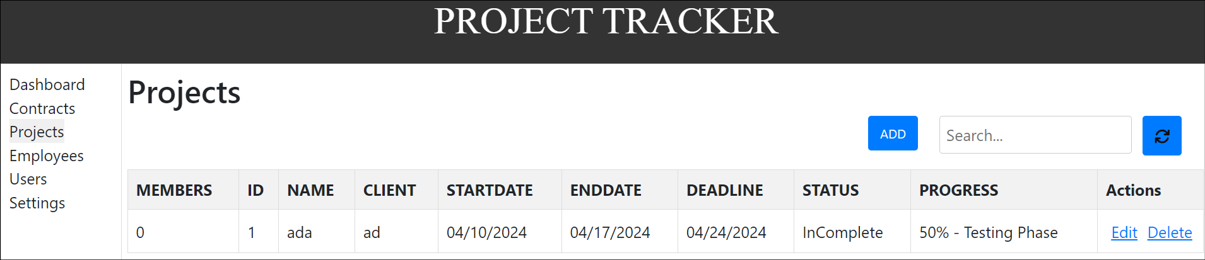
Project Tracker
Projects Tab UI

Slide 36
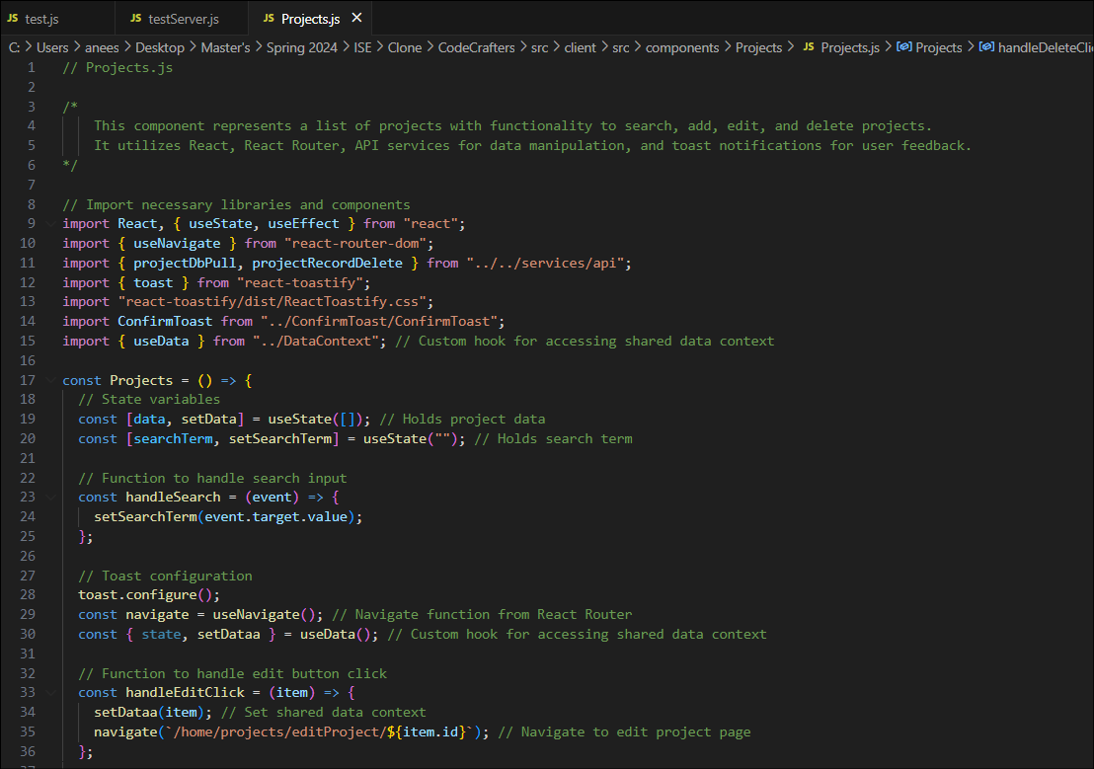
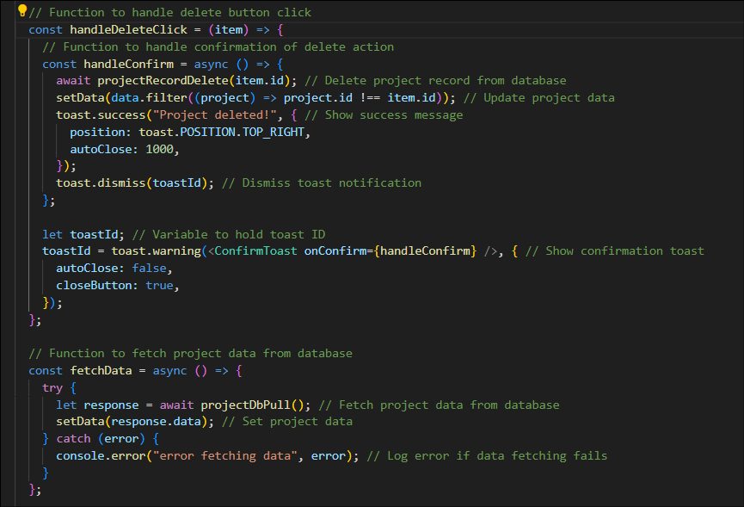
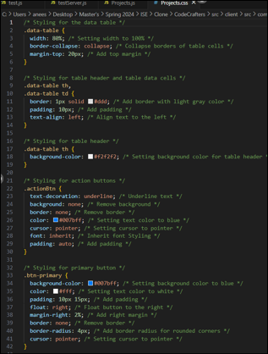
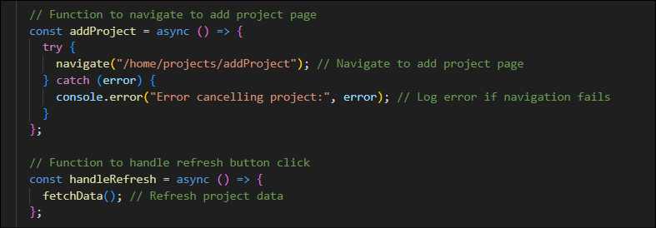
Project Tracker
Code Snippet

Slide 37
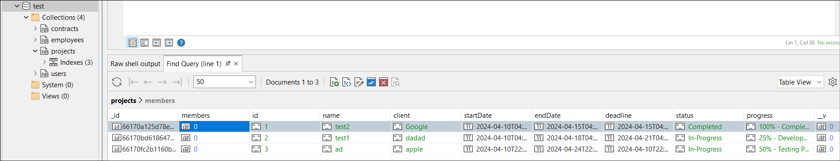
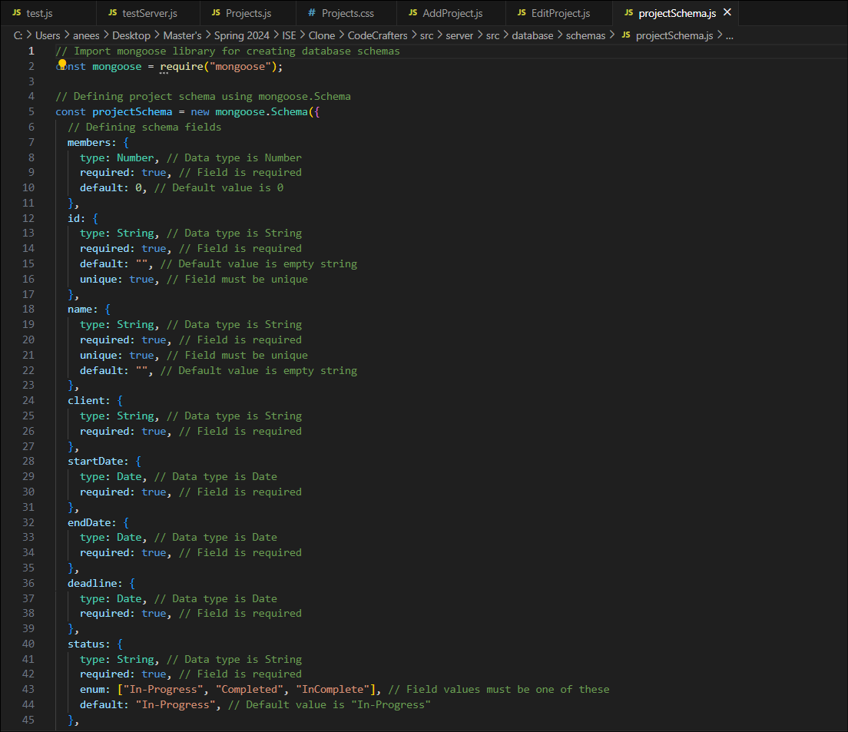
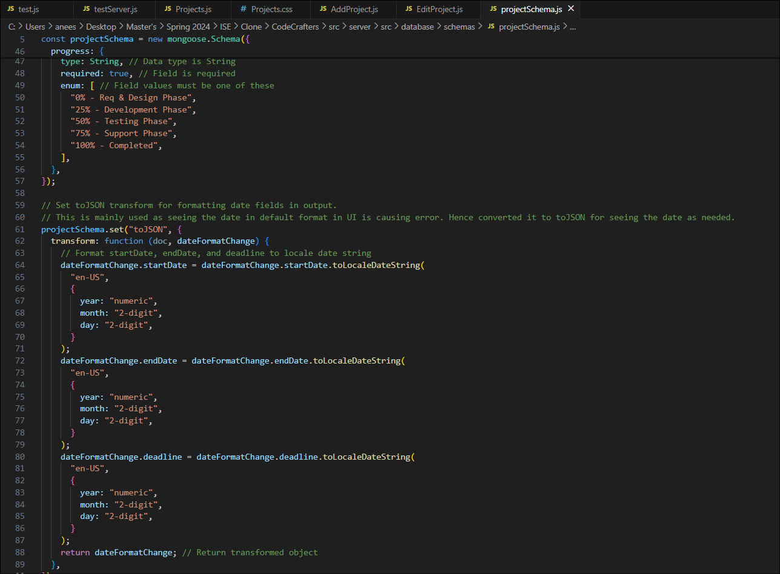
Database Schema
Project Tracker

Slide 38
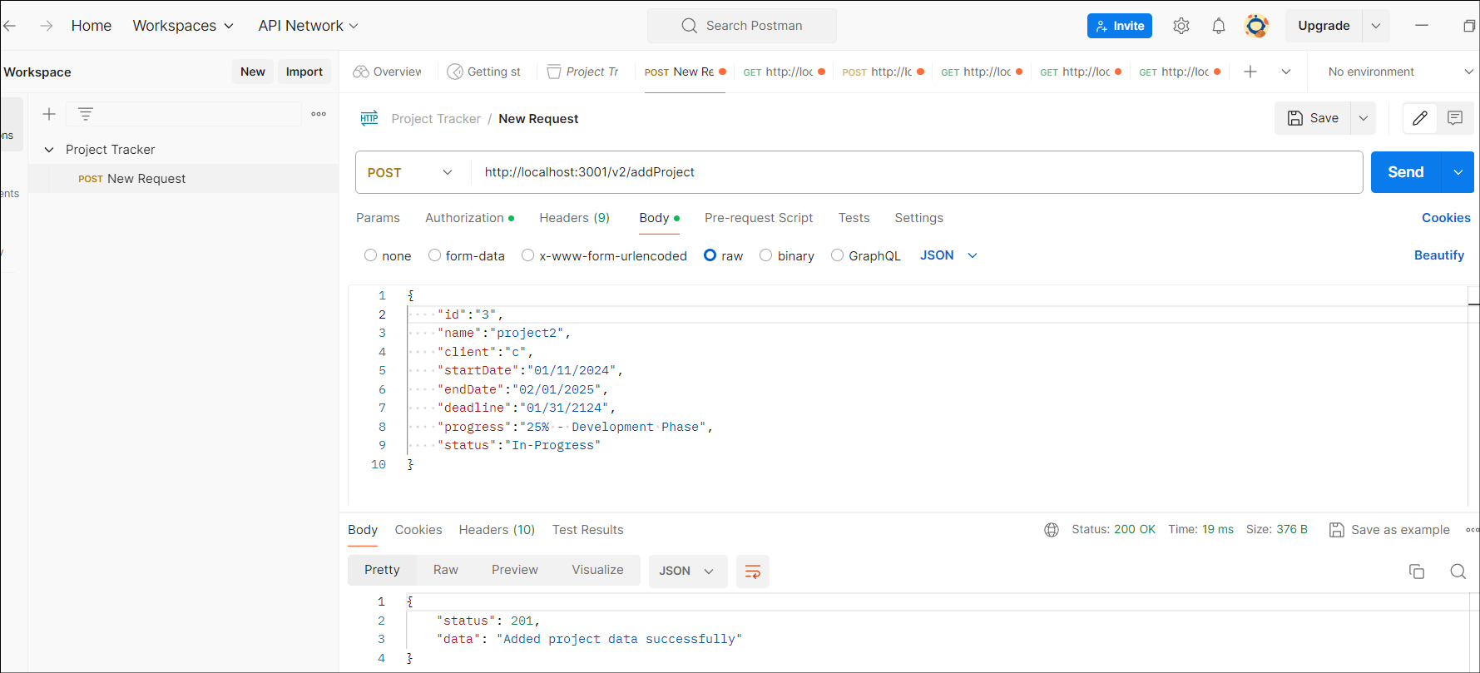
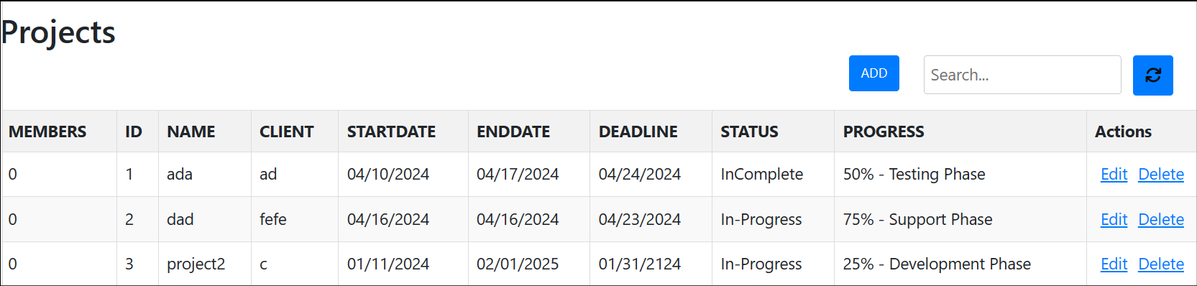
Project Tracker
Projects API
To add a project
API Type : REST
Method : POST
End point : /v2/addProject
Authorization : Bearer Auth

Slide 39
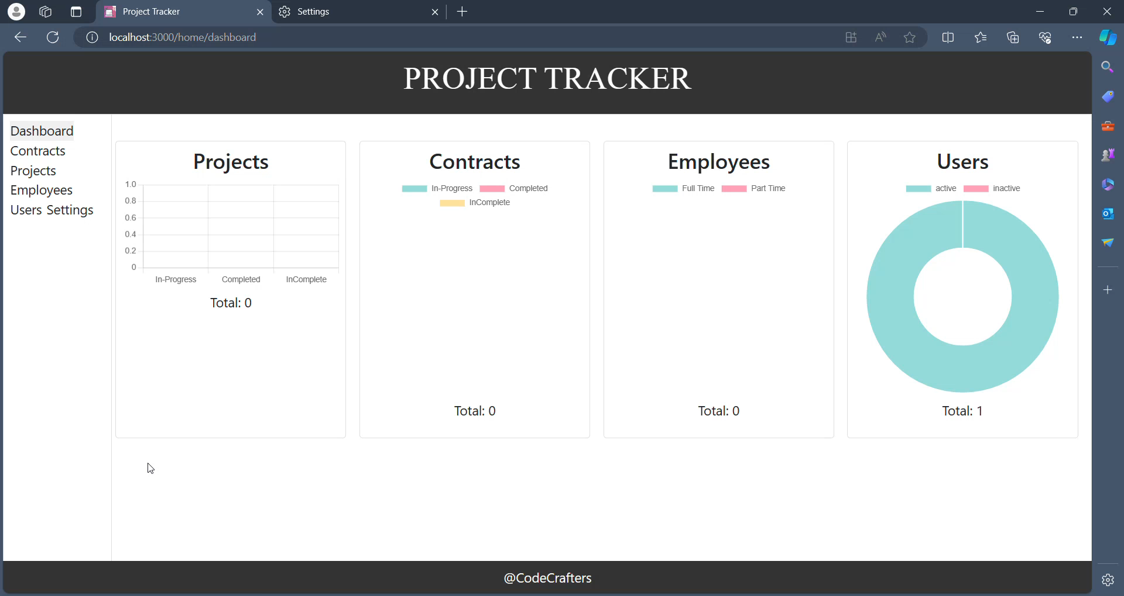
Project Tracker
Projects Tab

Slide 40
Project Tracker
Contracts Component
Introduction
The Contracts component serves as a dynamic contract management solution. It offers a table-top representation of contracts with search capabilities for convenient browsing. Contracts may be added, edited, and deleted by users, and the table reflects any real-time adjustments. This guarantees a current, well-organized, and easily accessible contract management platform.

Slide 41
Project Tracker
Contracts Component User Stories
List Contracts: As a user, I want to see all contracts in a table format, so that I can easily navigate through them.
Search Contracts: As a user, I want to quickly find contracts by typing into a search box and see dynamic results, so that I can get instant feedback.
Add New Contract: As a user, I want to add new contracts using a form and expect the system to validate my data so that I can ensure its correctness and completeness.
Edit Contracts: As a user, I want to edit contracts using a form that pops up when I click an "Edit" button so that I can easily modify contract details.
Delete Contracts: As a user, I want to delete contracts with a confirmation step, so that I can prevent unintentional deletions.
Real-time Updates: As a user, I want the table to be immediately updated after I edit or delete a contract so that I can see the current state of the contracts.

Slide 42
Project Tracker
Contracts Component Requirements
List Contracts: Display contracts in a tabular format for easy navigation.
Search Functionality: Provide a search box for users to find contracts by name with dynamic results.
Add New Contract: Include an "Add New Contract" button or link and a form for data entry. Validate the data for correctness and completeness.
Edit Contracts: Allow users to edit contracts using an "Edit" button or editable field in each contract row.
Delete Contracts: Include a "Delete" button or checkbox in each contract row. Ask users to confirm before deletion.
Real-time Updates: Update the table immediately after a contract is edited or deleted.

Slide 43
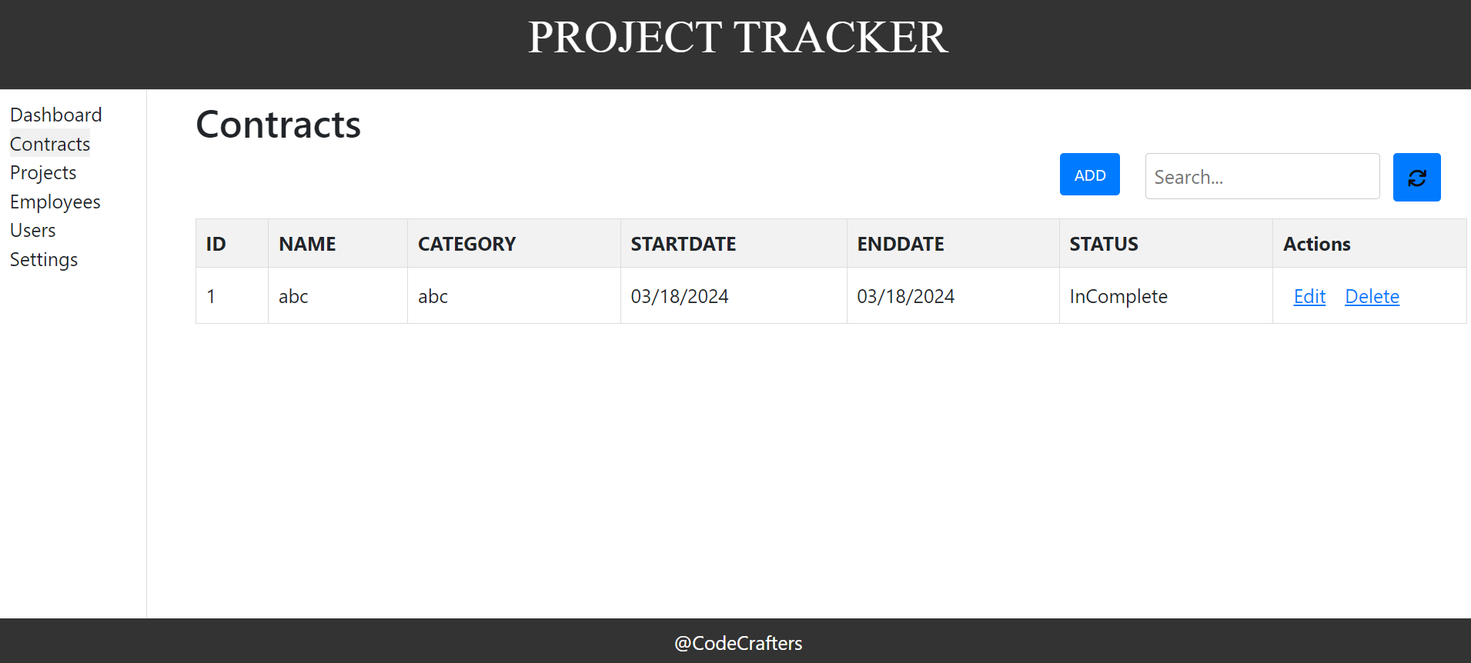
Project Tracker
Contracts Component UI

Slide 44
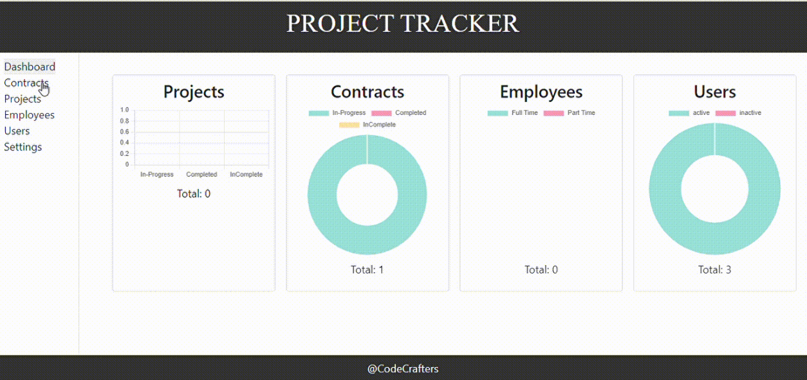
Project Tracker
Contracts Component UI

Slide 45
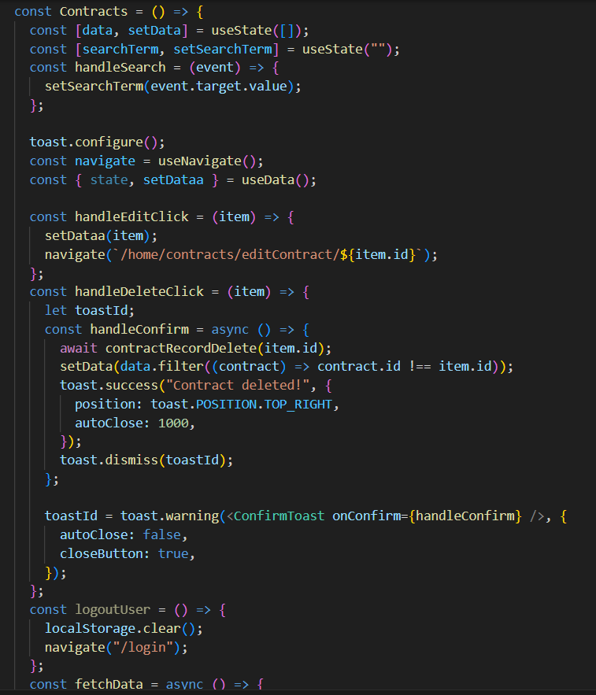
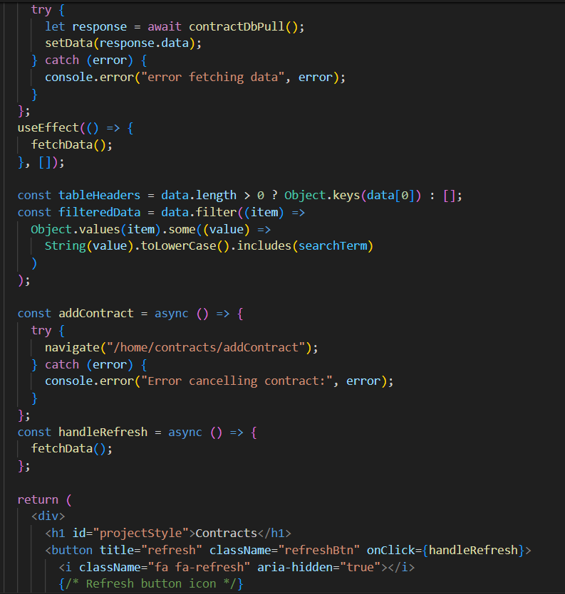
Project Tracker
Contracts Component Code

Slide 46
Project Tracker
Employees Component
Purpose of the Employees component.
Ability to modify, delete, and create employee details.
Immediate updates to the database.
Data synchronization for real-time updates.
Managers:
Admin role with the ability to modify employee details.
Can update employee projects, location, allocation dates, and roles.
Other Users:
Can view employee details and updates in real-time.

Slide 47
Project Tracker
Employee Component User Story
As a user, I want to see a list of all employees in a table format.
As a user, I want to search for employees by entering their names in a search box.
As a user, I want to add a new employee to the system.
As a user, I want to edit the details of an existing employee.
As a user, I want to delete an existing employee.
As a user, I want the employee table to update in real-time after edit or delete operations.

Slide 48
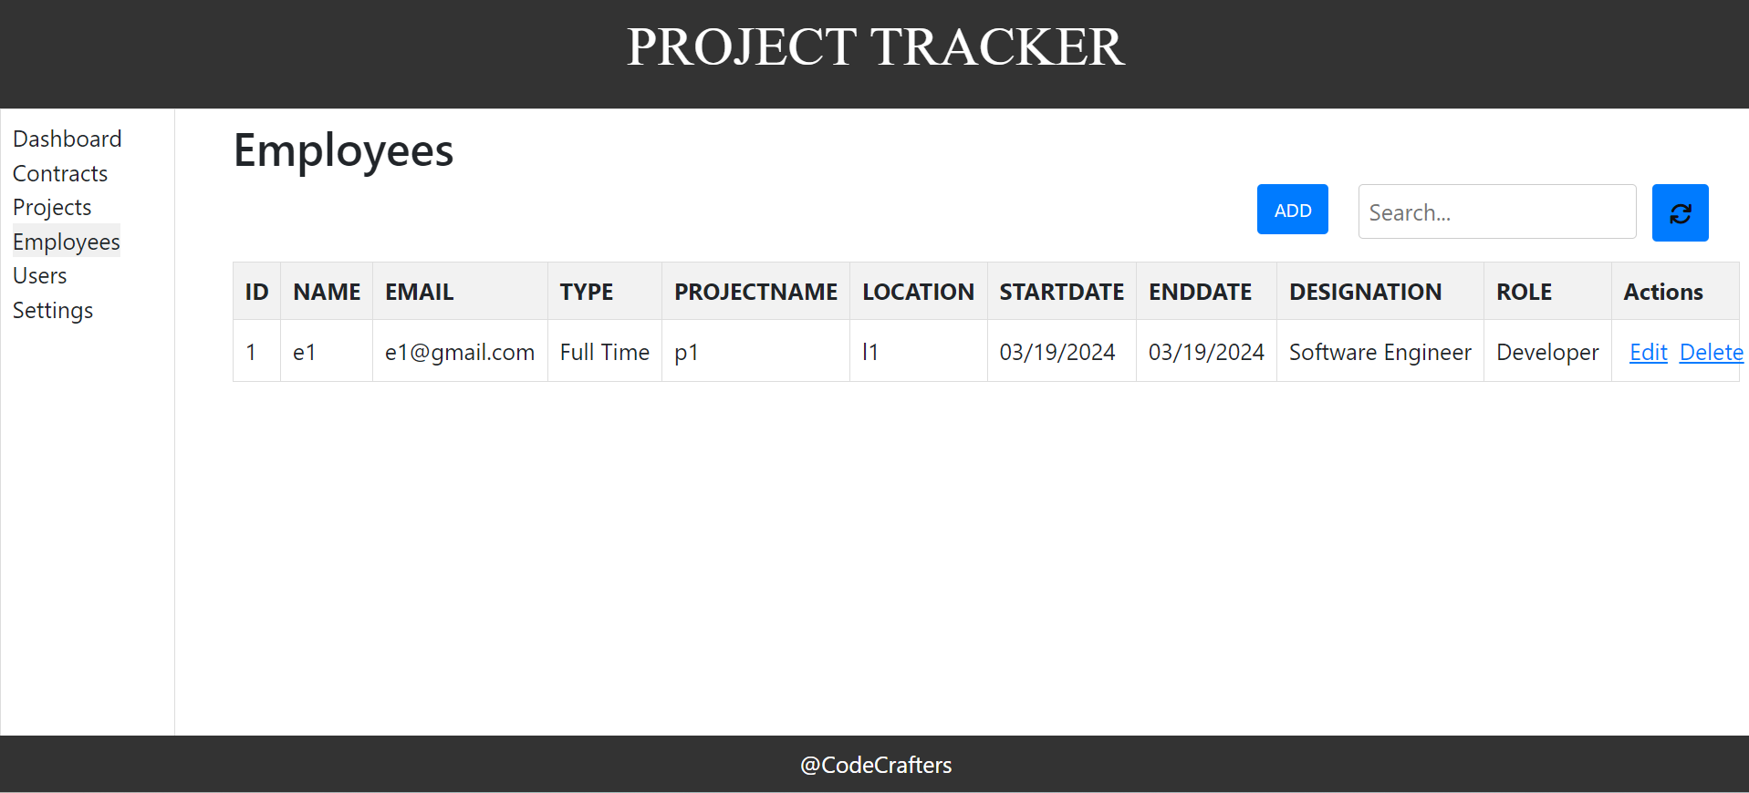
Employee UI

Slide 49
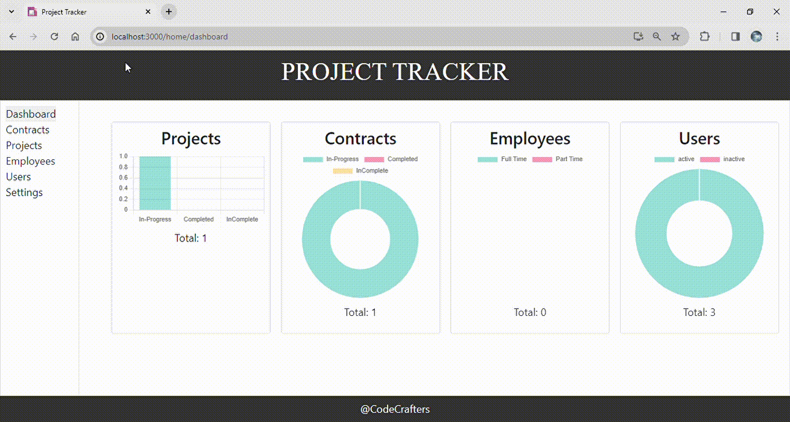
Employee UI

Slide 50
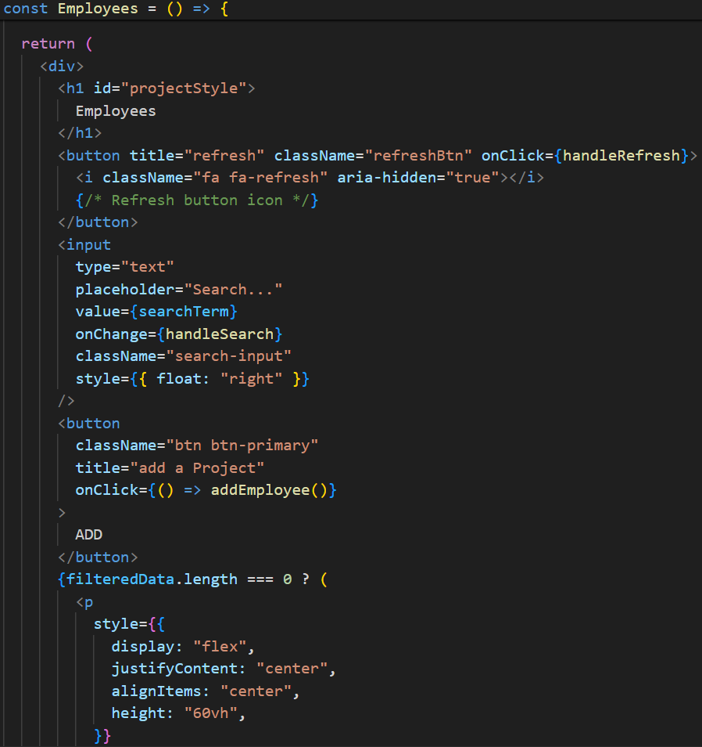
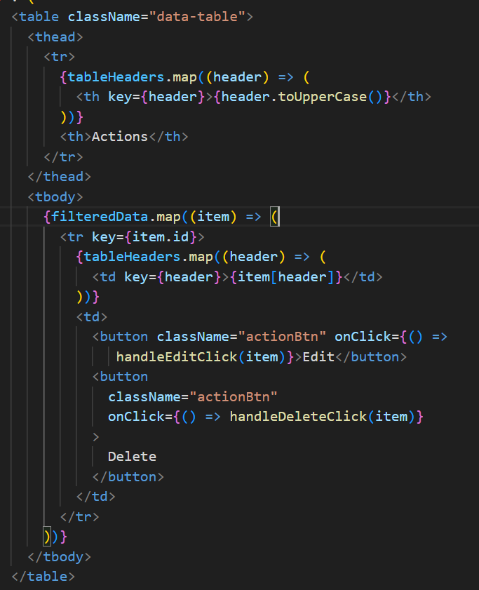
Project Tracker
Code Snippet

Slide 51
Project Tracker
Evaluation Criteria
The table should display columns for ID, Name, Type, Project Name, Location, Allocation Start Date,
Allocation End Date, Email, Designation, Role, and Actions (Edit, Delete).

Slide 52
Settings
Project Tracker
Introduction
The user settings page will allow users to see/update personal information. All the changes act as a query to the database and the tables get modified accordingly
Requirements
Profile Display: Shows the user's current information:
Username (read-only)
Email Address
First Name
Last Name
Edit Profile:
Edit Button: Triggers a form to edit user data.
Edit Form:
Pre-populated with existing data for:
Email Address (editable)
First Name (editable)
Last Name (editable)
Save Button: Submits changes and updates displayed information.
Logout: Provides a safe way for users to log out of the platform

Slide 53
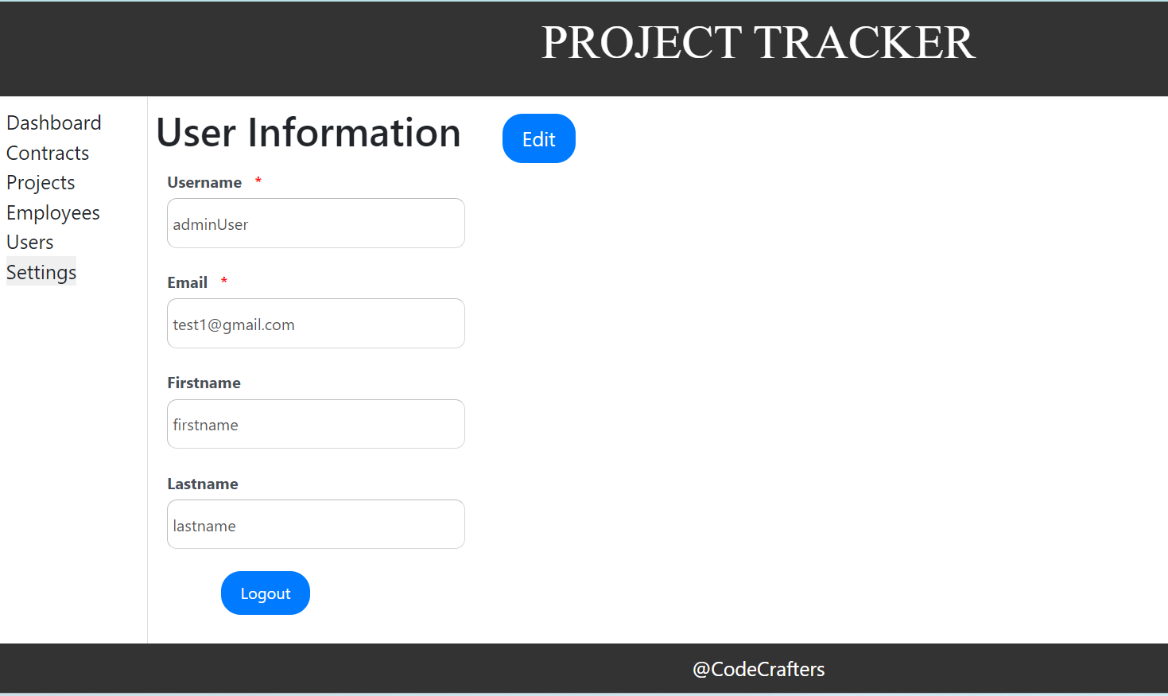
Project Tracker
Settings User Story
As a registered user, I want to view my current profile information, including username, email address, first name, and last name, so that I can easily see and manage my account details.
As a registered user, I want to edit my profile information, including email address, first name, and last name, within certain bounds, so that I can keep my information accurate and up-to-date
UI
Settings UI

Slide 54
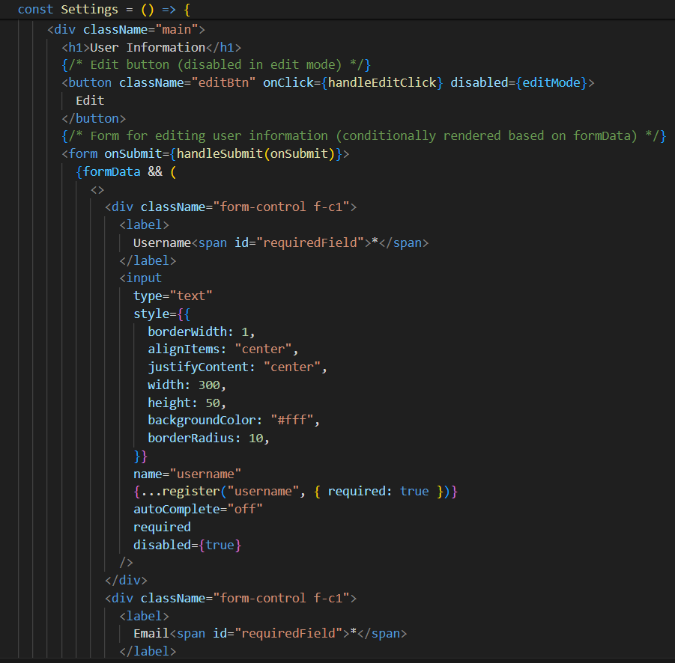
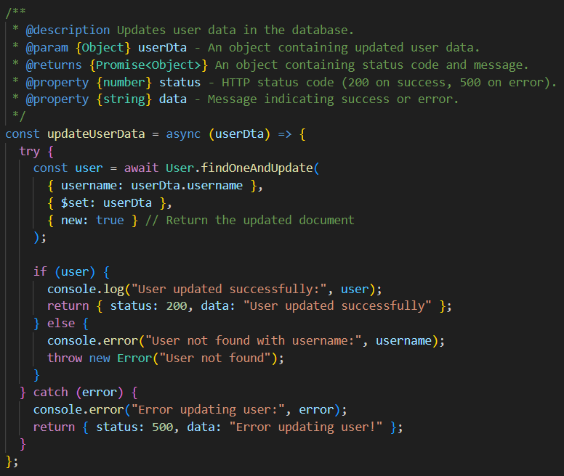
Project Tracker
USERS TAB Code Snippet

Slide 55
Project Tracker
USERS API’s
Get logged-in user info
Endpoint : /v2/getLoggedinUserData/{username}
Method: GET
Authorization: JSON Web Token
Update user data
End point : /v2/updateUserData
Method: POST
Authorization: JSON Web Token
Request payload: {"username":"adminUser","email":"test1@gmail.com","firstname":"firstname","lastname":"lastnam"}

Slide 56
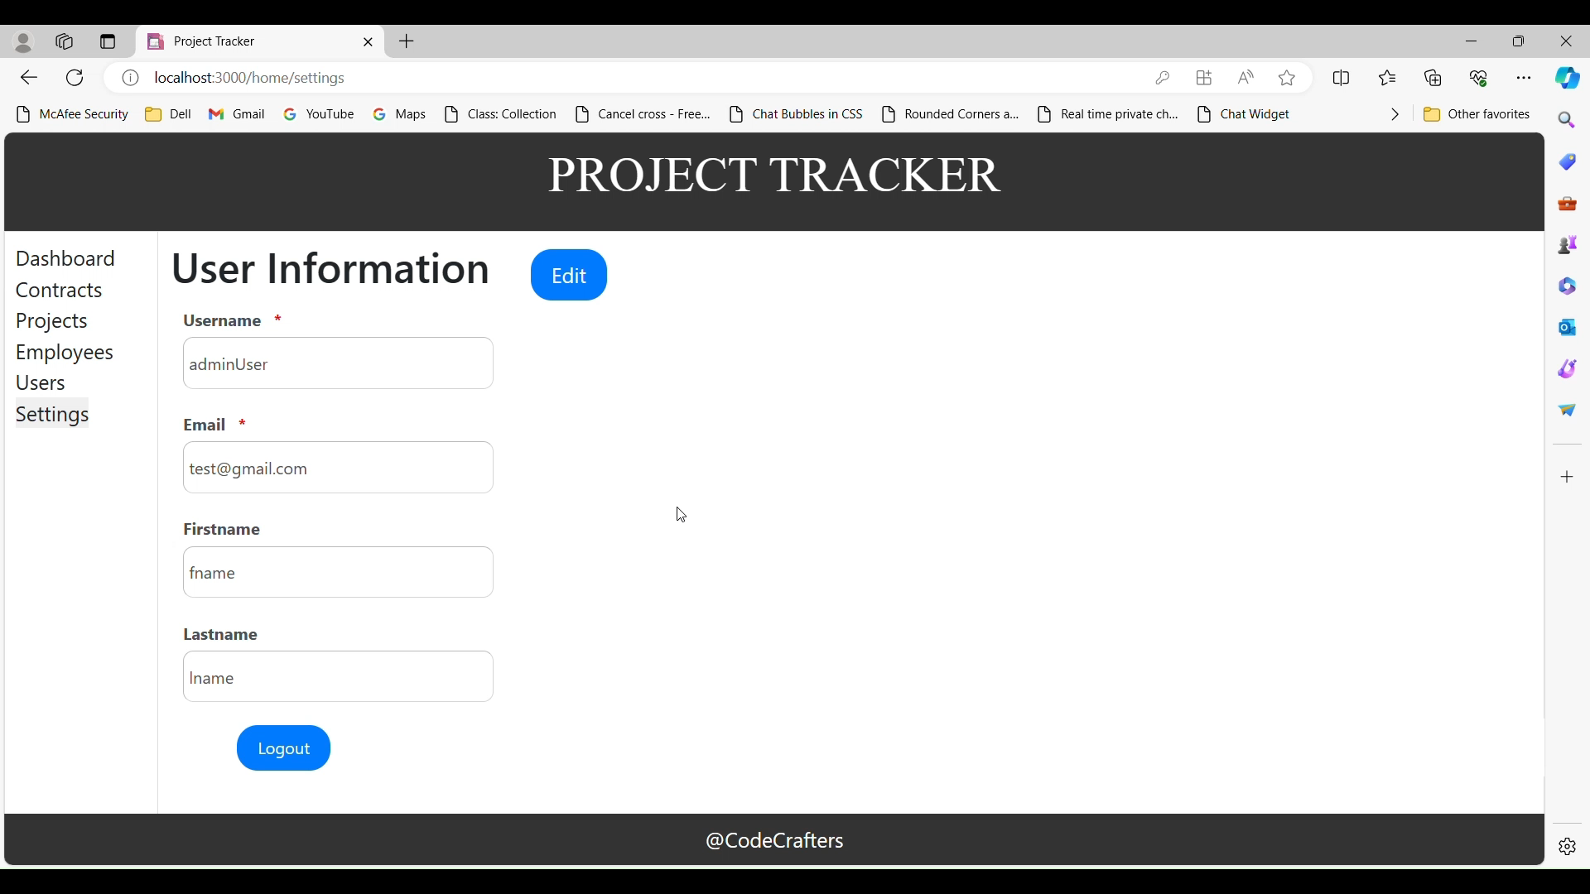
Project Tracker
Evaluation Criteria
User settings page showing current username, email, first name, and last name. Offers an "Edit" button to update editable information (first name, last name, and email format) with validation and error messages. Allows saving changes, undoing edits, and secure logout.

Slide 57
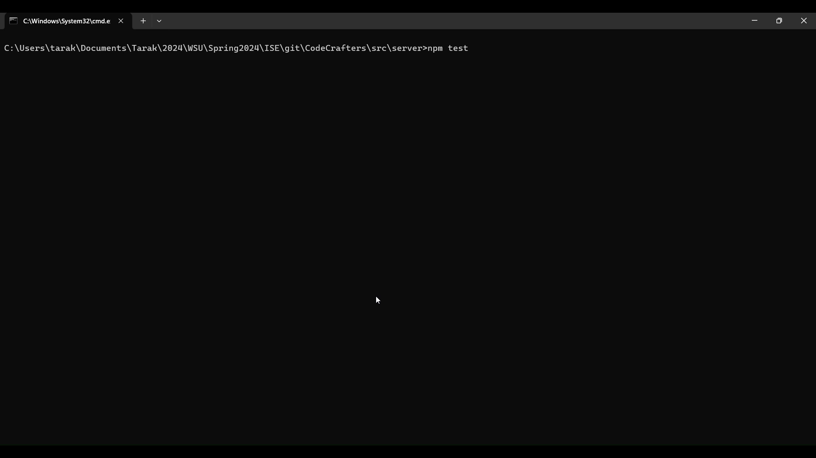
Project Tracker
Unit Test Cases

Slide 58
Project Tracker
What have we learned?
Software Development Process.
Exposed to GitHub.
Team collaboration.
Agile Methodology.

Slide 59
Questions?

Slide 60
THANK YOU

